Slide 1
AI-Based Resume to Job Matcher
BY
AP23110011487 - k. Mallikarjuna
Ap23110011489 – g. venkateswara rao
Ap23110011532 – k. likhith naik
Ap23110011535 – p. Prabhas

Slide 2

Introduction
Manual resume screening is time-consuming and error-prone.
Recruiters often miss good candidates due to volume and subjectivity.
The AI Resume Matcher automates the comparison of resumes to job descriptions using natural language processing (NLP) and machine learning,
Provides an objective, efficient, and scalable solution for candidate evaluation.

Slide 3
challenges
Extracting clean, structured text from unstructured PDFs/DOCX files.
Handling variations in skill naming (e.g., JS vs JavaScript).
Ensuring semantic understanding for pattern matching.
Performance issues when handling large resumes or job descriptions.

Slide 4
System architecture
Frontend: Built using HTML5, CSS for responsive design, and JavaScript for interactive behavior.
Backend: Flask handles API requests and business logic.
Resume Parsing: PDF and DOCX files are parsed using PyPDF2 and python-docx.
Matching Logic: Text similarity (TF-IDF + Cosine Similarity)Skill extraction (regex + NER)Experience and role classification (transformers)

Slide 5
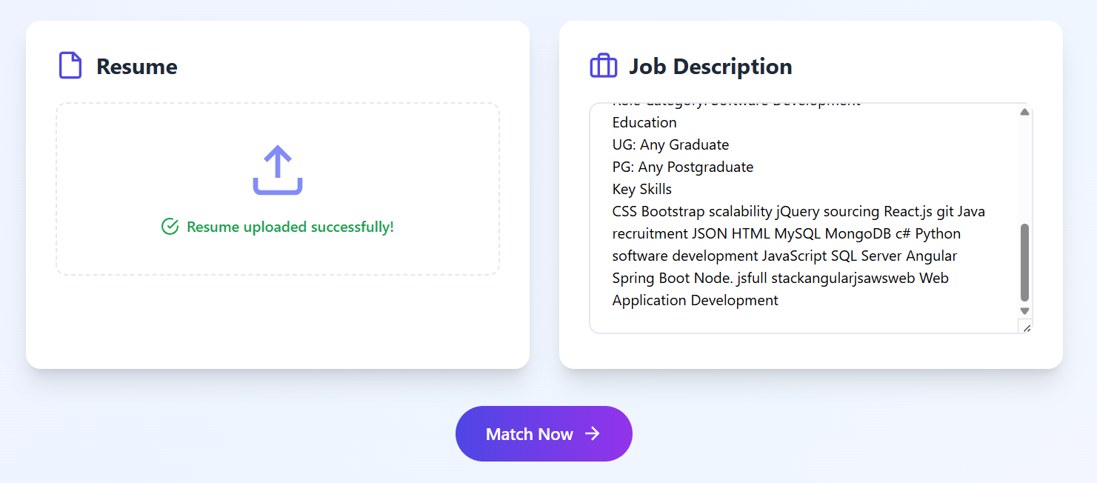
features
Upload resumes in .txt, .pdf, or .docx formats.
Paste job descriptions directly into the interface.
Real-time analysis with:
Skill match%
Text similarity%
Experience estimation
Clear display of matched and missing skills.

Slide 6
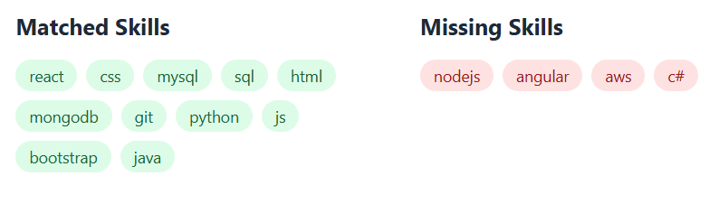
Skill matching logic
Uses both pattern-based and fuzzy logic for skill detection.
Patterns handle variations like React, React.js, ReactJS.
Matching threshold: 0.85 similarity ratio (SequenceMatcher).
Extracted from both resume and job description for comparison.

Slide 7
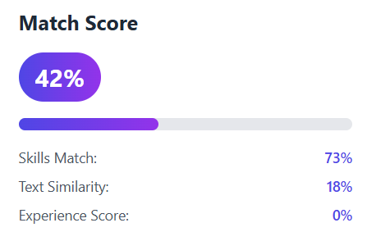
Match score calculation
Skill Match Score (50% weight):
Ratio of matched skills to required skills
Text Similarity Score (30% weight):
TF-IDF vectorization + cosine similarity
Experience Score (20% weight):
Normalized from 0–10 years = 0–1 scale
Final Score = Weighted average of the three
Score shown with percentage and color-coded bar

Slide 8
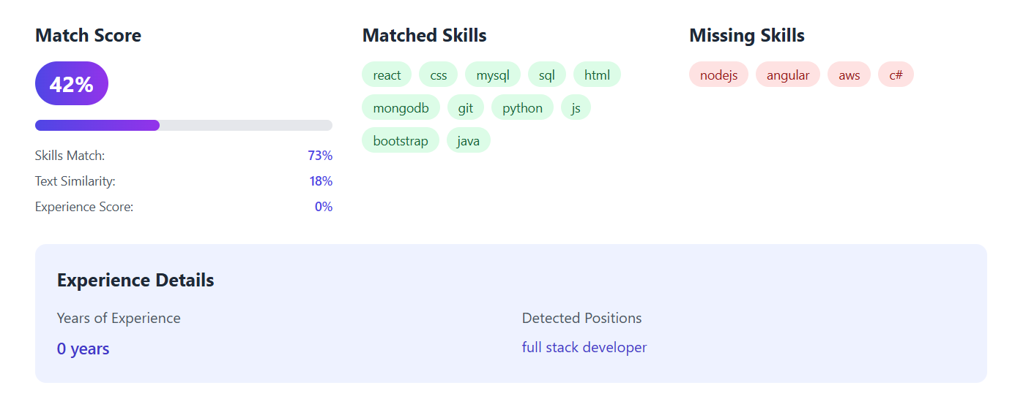
Results & Output Example

Slide 9
Future work
Rank multiple resumes for a given job description.
Integrate the LinkedIn or GitHub API for real-time resume building.
Use deep learning for even more contextual understanding.

Slide 10

THANK YOU

